Slide 1
2015/16 EHA Bookkeeper Meeting
May 6-15, 2015

Slide 2
Statewide, Nationwide, and Around the World
Blue Plans represents the nation’s largest and most experienced health care benefit companies.
Blue Plans cover 100 million people—nearly one-third of all Americans—in all 50 states, the District of Columbia and Puerto Rico.
Blue Cross and Blue Shield of Nebraska insures or provides benefit administration for more ^{than 700,000 people.}
Members have access to:
92%
Physicians
96%
Hospitals

Slide 3
Introductions
BCBSNE
Kent Trelford-Thompson
Sue Warner
Tara Stevenson
Linda Farahani
Sam Nowatzke
Speakers
Twyla Swearingen
Litsa Shoemaker
Howie Halperin
Linda Kenedy
Greg Long

Slide 4
Agenda
Electronic Enrollment and BluesEnroll
Subgroup Application
Renewal Timeline
Administrative Updates
Direct Bill
Break
Payflex (Your COBRA Administrator)
EHA Wellness Program
EHA Field Representative
2015/16 Plan Designs and Rates
Open Discussion

Slide 5
Electronic Enrollment
BluesEnroll

Slide 6
Electronic Enrollment
Blue Cross Blue Shield of Nebraska partners with Benefitfocus to offer our groups an electronic enrollment option.
The Benefitfocus® platform is branded as BluesEnroll, and it provides an internet-based enrollment solution for employers.
It offers employers the ability to administer their benefit offerings and information through a web-based platform.
BluesEnroll is an online enrollment tool available through Benefitfocus, an independent company not affiliated with Blue Cross and Blue Shield of Nebraska.

Slide 7
Capabilities
With BluesEnroll, you can make employee changes electronically, 24 hours a day 7 days a week, from anywhere with Web access, eliminating the need to send paper forms.
BluesEnroll is configured based on your group’s business rules and provisions so you can:
Make year round life event changes
New hire benefit elections
New hire declinations
Employee terminations
Rehires
Address changes

Slide 8
2015 BluesEnroll Group Set Up
All groups will be set up in the BluesEnroll system allowing Open Enrollment changes to occur.
When you are in the BluesEnroll system under the Open Enrollment tab when you edit benefits you will see two options:
One will allow you to complete Special Life Event changes
One will be your selection for Open Enrollment changes

Slide 9
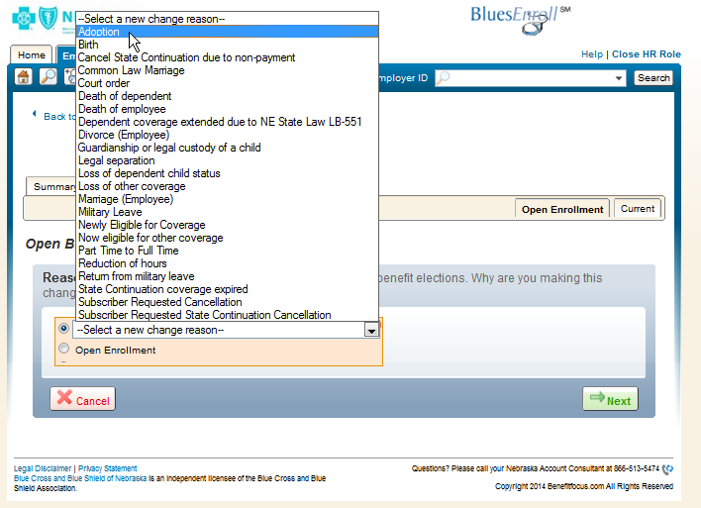
BluesEnroll Group Set Up Cont.
If your group size is 50+ then you have a choice concerning whether you offer an open enrollment or not, however, both options that we discussed on the previous slide will still appear.
If you choose not to allow an Open Enrollment, then you will be responsible for only entering the changes that are a result of a qualifying event.
You will have the ability to indicate what that event is as you normally would by expanding the drop down box.

Slide 10
Things to Remember
Once the Renewal set up is complete you will be allowed in to begin to make your Open Enrollment and/or Life event changes. When you select Benefits Detail from the members landing page, you will be redirected to the benefit tab. You will see two tabs Open Enrollment and Current. This represents the time period.
The Open Enrollment tab is for the 9-1-2015 through 8-31-2016 time period.
The current tab is for the 9-1-2014 through 8-31-2015 time period.
Be sure you select the correct tab based on the effective date of the changes you are completing.

Slide 11
Things to Remembers
Changes that are needed that are effective in the current participation period but carry over to the Open Enrollment participation period, need to be held until the renewal set up is completed.
If you proceed with the change prior to the Open Enrollment tab being created, there is a chance that your change will not show up in the new participation period.

Slide 12
Mark Your Calendars
Important Dates to Remember:
Sub Group Applications are due by Wednesday, July 1st, 2015.
BluesEnroll Lock Out will begin on Monday, July 6th (it will actually be locked at the end of business on July 3rd) through Friday, July 31st, 2015.
BluesEnroll will be Unlocked and ready for adds, changes and terms on Monday, August 3rd, 2015.
Open Enrollment changes can be entered from Monday, August 3rd through Monday, August 31st, 2015.
Open Enrollment will be closed at the end of business on Monday, August 31st, 2015.

Slide 13
New Administrator
If you are or have a new administrator that needs access to BluesEnroll, please send a letter on your school’s letterhead with the following information:
New user full name
Title
Phone number
Fax number
Send your request to your Marketing Account Team and they will complete the necessary steps to provide the additional access.

Slide 14
Training
Benefitfocus offers an in-depth, one-hour training session.
To register for a time that fits your schedule, go to http://www.benefitfocus.com/trainings/online-enrollment/.
There are many HR admins on the line during the training, so it is not specific, but it is very helpful.

Slide 15
Training
Online Enrollment Training
This training will cover how to utilize the Online Enrollment application for benefit enrollment and maintenance. This session will cover all aspects of employee benefit management, such as initial enrollment, terminating employment, cancelling benefits and making changes due to life events.

Slide 16
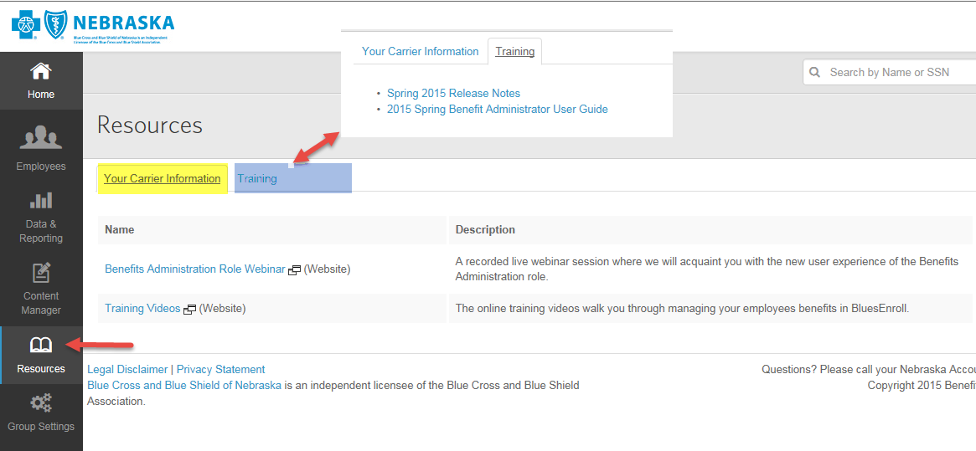
On-line Tools

Slide 17
BluesEnroll Support
You have many levels of support.
BCBSNE eEnroll Support Team
Is available to assist in resetting your login credentials or navigating through BluesEnroll system. Please contact us at eEnrollSupportTeam@nebraskablue.com.
Benefitfocus BluesEnroll Support Line
You will find the BluesEnroll Support Line phone number in the bottom right corner of each screen in BluesEnroll.
All other concerns should be directed to your BCBSNE Marketing Account Team.

Slide 18
EHA Subgroup Application & Web Portal
Samantha Nowatzke

Slide 19
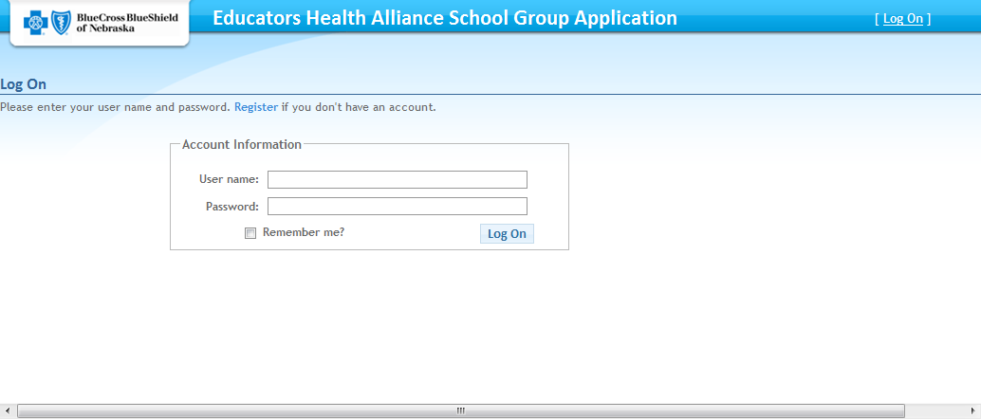
Sub Group Application

Slide 20
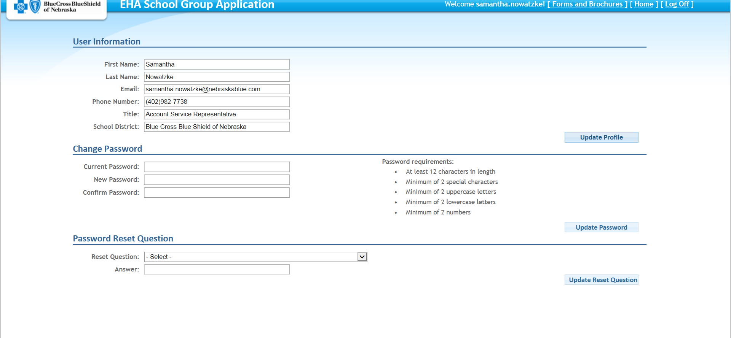
Subgroup Application

Slide 21
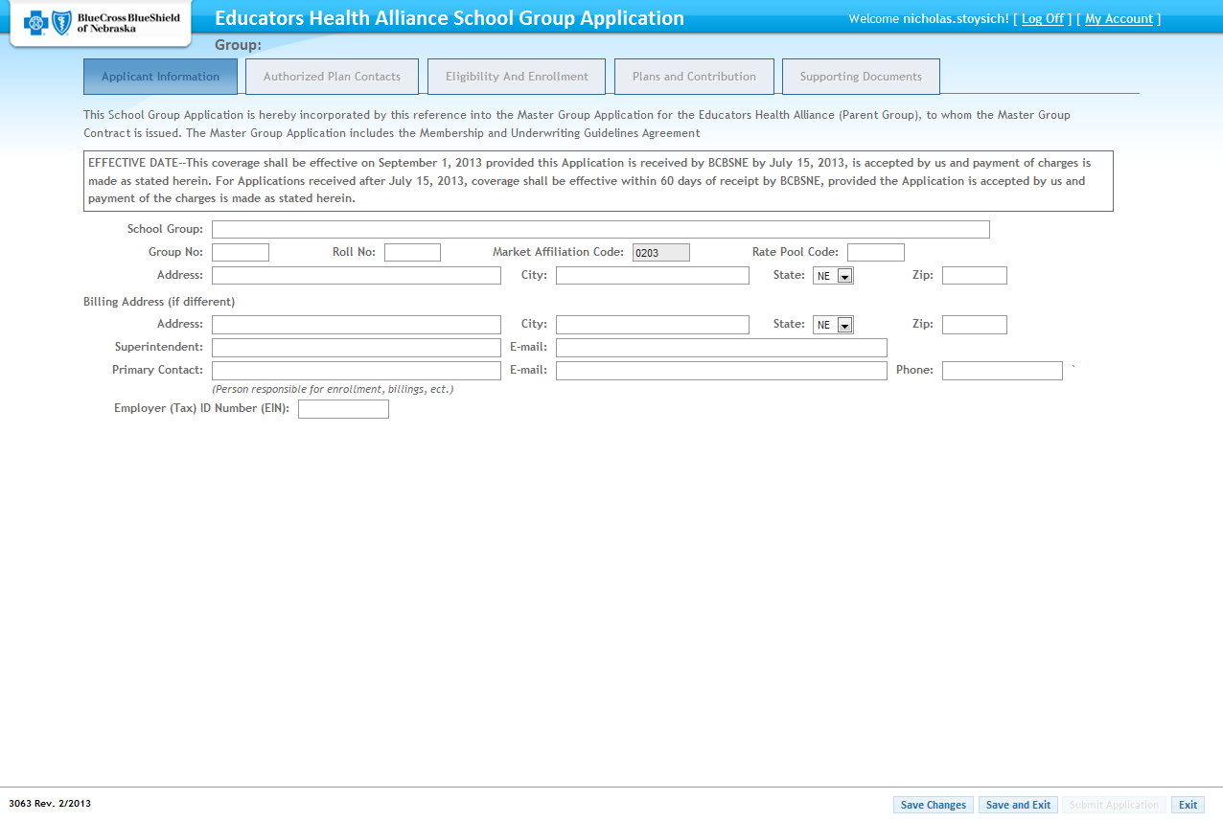
Sub Group Application

Slide 22
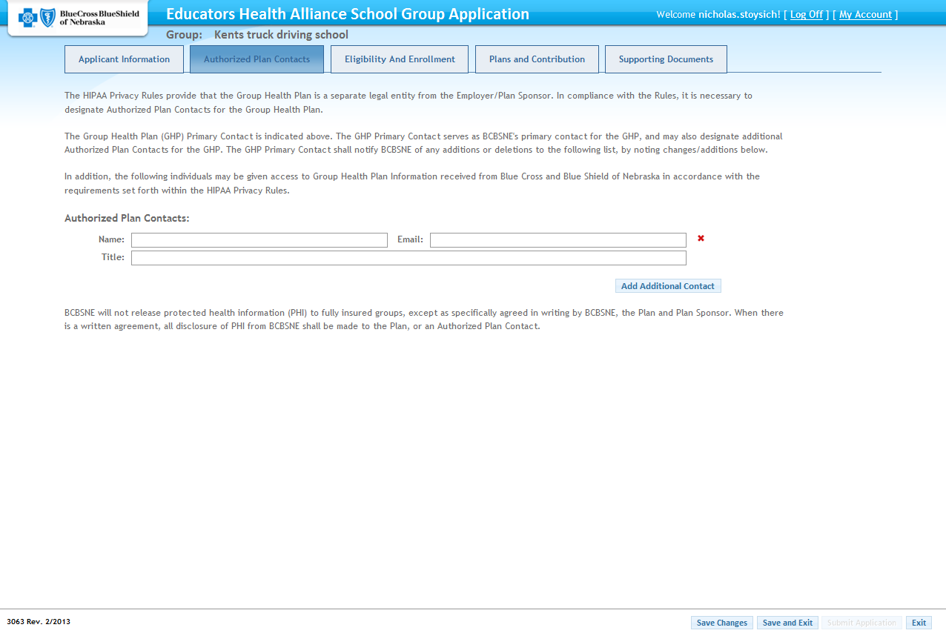
Sub Group Application

Slide 23
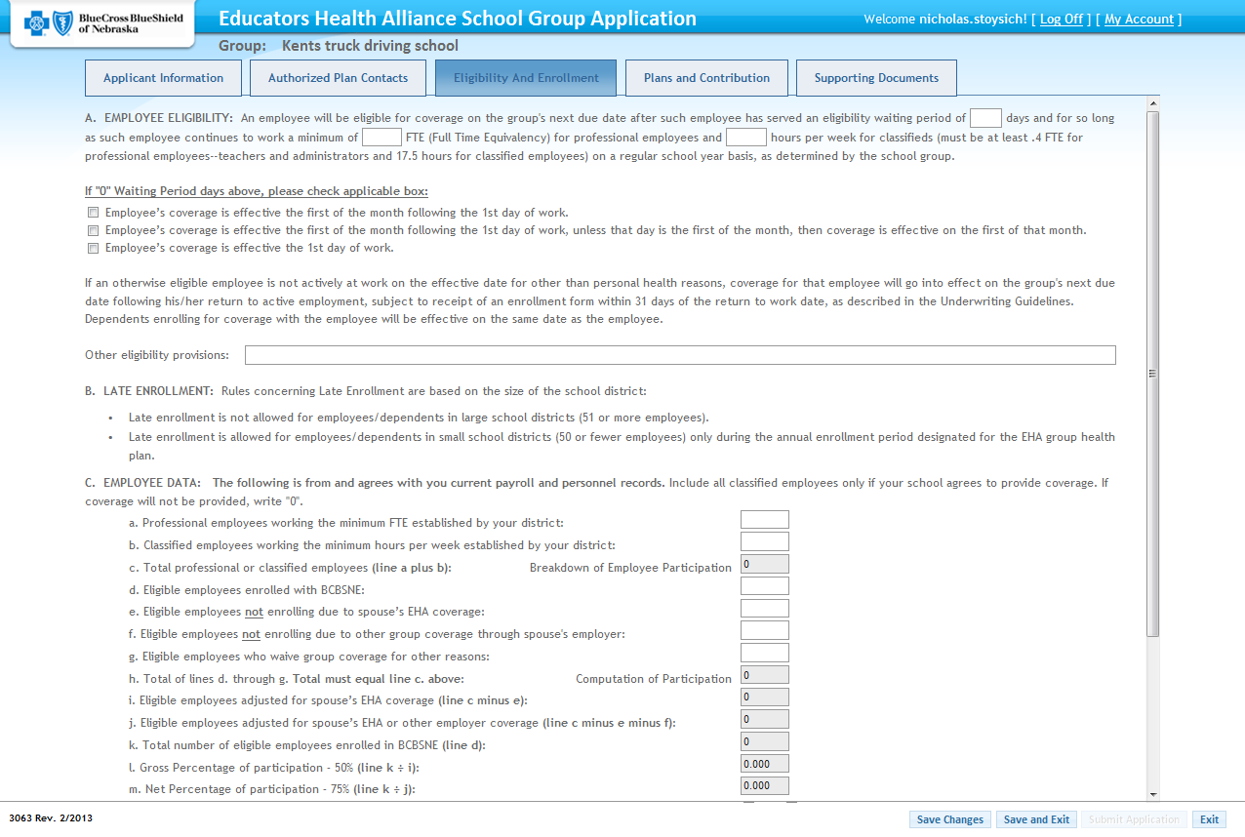
Sub Group Application

Slide 24
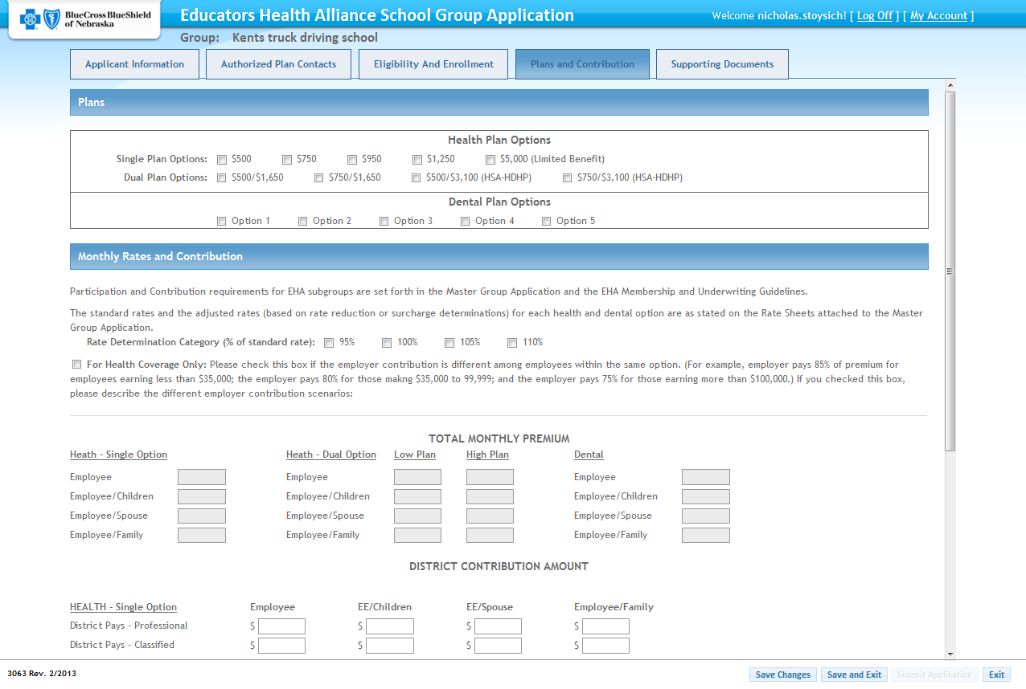
Sub Group Application

Slide 25
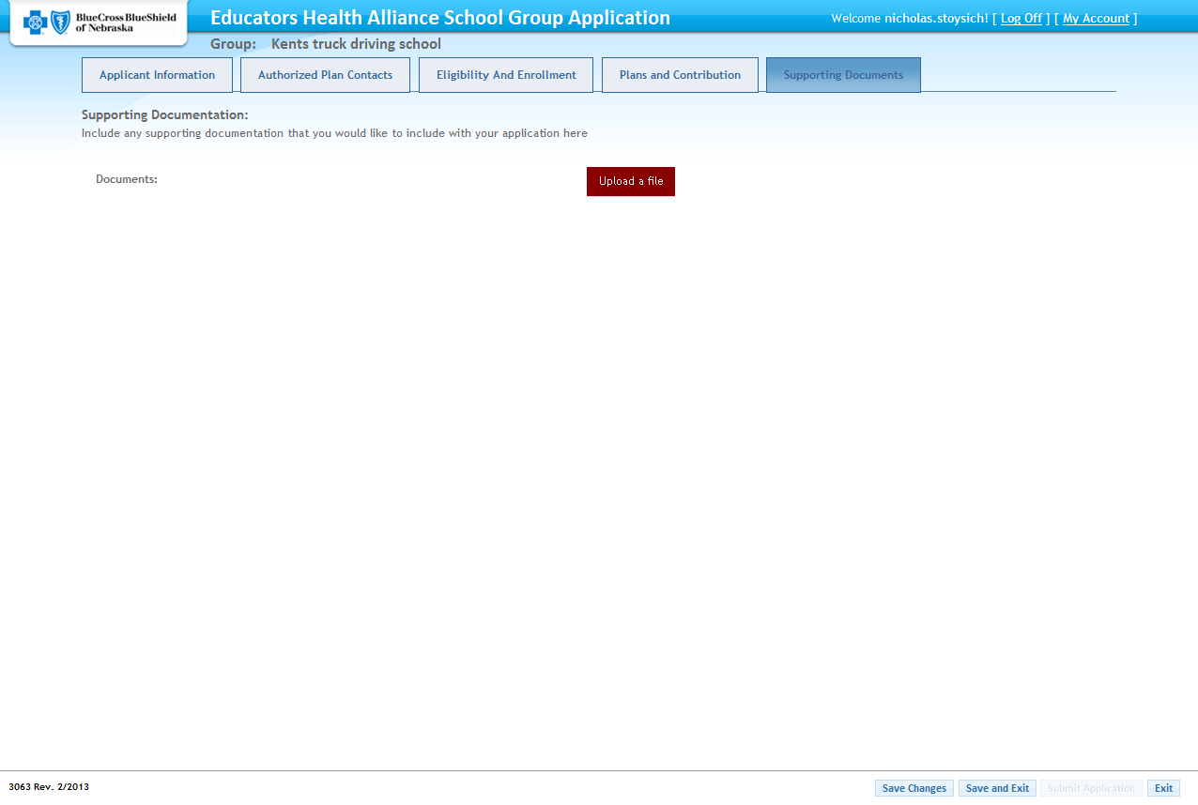
Sub Group Application

Slide 26
Sub Group Application

Slide 27
Renewal Time Line
May 6th Bookkeeper Meetings Start
May 15th Bookkeeper Meetings End
July 1st Sub Group Applications Due to BCBSNE
July 6th (end of business day July 3rd) BluesEnroll Lock Out Begins
August 3rd BluesEnroll Lock Out Ends
August 3rd Open Enrollment Changes can be made
August 31st Open Enrollment Ends
May 18th
Renewal Website Opens

Slide 28
Administrative Updates
Sue Warner
Regional Service Representative
Tara Stevenson
Regional Service Representative

Slide 29
ACA Reminder
On Monday February 10th 2014 the Treasury Department announced new rules.
51 – 99 Life Groups- Employer Mandate completely delayed until 2016. If they don’t offer coverage, Minimum Value Coverage or it’s not affordable, there are no penalties in 2014 or 2015.
100+ Life Groups – Employer Mandate (as of now) will go into effect in 2015. The major change for these employers is coverage now only has to be offered to 70% of employees vs. the previous requirement of 95%.
Non-calendar year plans: Employers with plan years that do not start on January 1 will be able to begin compliance with employer responsibility at the start of their plan years in 2015 rather than on January 1, 2015.

Slide 30
IRS Codes 6055 (Carriers) & 6056 (Employers)
Starting in 2016 for the 2015 tax year, the Affordable Care Act (ACA) requires both consumers and companies with 50 or more full-time equivalent (FTE) employees report information to the Internal Revenue Service regarding their health insurance coverage to comply with the Employer Shared Responsibility and Individual Coverage mandates.
IRS Section 6055 governs the reporting requirements made by providers of health care coverage (e.g. insurance companies) and Section 6056 governs the reporting requirements for employers who offer health care coverage to their employees.
There’s a lot of information to digest. We’ve put together this overview to get you familiar with some of the key elements of the requirements. We also hope it will help you start thinking about what you need to start doing now to prepare for next year. (Reporting is voluntary this year, but employers may find it valuable to do so as a “rehearsal” for next year. More about that in a bit.)

Slide 31
IRS Codes 6055 (Carriers) & 6056 (Employers)
Tax year 2014
Employer reporting is voluntary.
For individual tax filings, people will only be asked to confirm that they had health insurance in 2014. They can use a variety of documentation to provide proof of health insurance, including such things as their W-2 from their employer, insurer Explanation of Benefits forms, cancelled checks showing premiums paid, etc. Blue Cross and Blue Shield of Nebraska members who are registered at www.mynebraskablue.com can print out the information found in the “Who’s Covered” section for documentation purposes.

Slide 32
IRS Codes 6055 (Carriers) & 6056 (Employers)
Tax year 2015
All individual plans must comply with reporting requirements.
All groups with 50+ FTE employees must comply with the reporting requirement. Please note that groups with 50-99 FTE employees must comply with the reporting requirement but do not have to comply with other Employer Shared Responsibility requirements until 2016.

Slide 33
IRS Codes 6055 (Carriers) & 6056 (Employers)
Tax year 2016 and afterward
All individual plans must comply with reporting requirements.
All groups with 50+ FTE employees must comply with the reporting requirement and all other Employer Shared Responsibility requirements.

Slide 34
IRS Codes 6055 (Carriers) & 6056 (Employers)
BCBSNE will issue Form 1095-B to all members of fully-insured group plans and send an electronic transmittal to the IRS. Form 1095-B will contain the following information:
Employee’s name, date of birth and Social Security Number
Employer information
Insurer information
Name, date of birth, and Social Security Number for every family member covered under the employee’s membership
The months of the previous year each family member had coverage under the plan.

Slide 35
IRS Codes 6055 (Carriers) & 6056 (Employers)
The employer group must issue a 1095-C to all their employees. Fully-insured groups should be able to populate their 1095-C forms with the information they receive from their payroll and W-2 systems.
Employees will use the 1095-B and 1095-C forms they receive from BCBSNE and their employer for their individual income tax filing

Slide 36
My Blue
www.mynebraskablue.com
At Blue Cross and Blue Shield of Nebraska, we think everyone should be able to understand their health insurance, so they can make better decisions about their health. So we created myblue – a self-service website that makes sense of your medical bills and health care spending – all in one place:
Track your health care spending
Access your mobile ID card or order printed cards
Print a summary of your claims activity
Find a doctor close to work or home
Get in touch with us

Slide 37
Back to School Meetings
If you would like a BCBS representative to come talk to the staff about benefits please send Sue or Tara an email with the date(s) and time by June 15th. Our schedules fills up quickly and we will try our best to meet every request.

Slide 38
Additional Administrative Updates/Direct Bill
Linda Farahani
Account Service Representative

Slide 39
Direct Bill/Early Retiree Coverage
Email or Fax the EHA Notice of Early Retiree Form to Linda in the Lincoln office at (402) 477-2952.
Please include all members over 50 years of age that are leaving the school.
Make sure to include the EHN ID # that can be found on your current billing statement.
You will need to notify PayFlex of any terminations, however please do not notify them prior to August 1st.
You will still need to terminate member in BlueEnroll.
Direct Bill packets will be mailed the 2nd week of July with coverage terminating on 8/31/15.

Slide 40
Direct Bill and Medicare Supplement Coverage
If the retiree is over the age of 65 he/she will be sent a NSEA-Retired BlueSenior Classic.
As members whom are enrolled on the Direct Bill plan reach age 65, we will send a Medicare Supplement packet to them 60 days prior to there 65th Birthday.
Members reaching age 65 who have dependents on the Direct Bill plan. The member turning 65 will move to the Medicare Supplement while the dependent remains on the Direct Bill plan, until they reach age 65.

Slide 41
EHA Field Representative
Greg Long
EHA Field Service Representative

Slide 42
Open Enrollment Affidavit
The EHA Board is pleased to announce that at its February 6, 2015 meeting the following resolution was passed:
Motion: “An Open Enrollment period for the 2015-16 plan year for all groups unless both the district and the local Association approve of opting out.”
The above resolution will result in all EHA subgroups having an Open Enrollment unless
it is decided at the local level to opt out. This opting out may be applied at the subgroup
level and requires the employer and the bargaining unit (for subgroups where one exists) to sign off on the desire to opt out. Sub-Groups may opt out of the Open Enrollment by completing and returning a form to Blue Cross Blue Shield of Nebraska. The EHA BCBSNE 2015-16 Open Enrollment Opt Out Form will need to be completed and returned to Blue Cross Blue Shield of Nebraska no later than July 1, 2015.

Slide 43
Dependent Eligibility Verification
The verification of correct dependent eligibility is a process conducted to ensure that only eligible individuals are covered under the EHA health insurance program, which in turn helps keep costs as low as possible for EHA members.
Xerox Security Statement can be downloaded from the EHA Website. www.ehaplan.org
You will termination and reinstatement lists from BCBSNE representatives that have come directly from Xerox. Please make sure you open these e-mails.
Xerox help hotline 855-874-8505. Members with questions about the process should contact Xerox directly since they are conducting the audit.

Slide 44
EHA Website Updates
Affordable Healthcare updates and announcements
Executive board announcements
Schedule of events including webinars and upcoming retiree seminars
Frequent asked questions box for school districts regarding ACA (Link to Blue Cross Blue Shield of Nebraska

Slide 45
2015/16 Rates

Slide 46
What's on your Mind
Thank you for taking your time to attend.
Have a nice day!
Drive Safe

