Slide 1


PAYFLEX COBRA
ADMINISTRATION
May 2015

Slide 2
Today’s Agenda Topics
Summary of Services
New Hire Administration Overview
COBRA Administration Overview
COBRA Responsibilities
HealthHub
2

Slide 3
PayFlex Contact
Primary EHA Contact:
Mike Owens, Client Service Manager
  mowens@payflex.com
  402-758-7880
COBRA Call Center
  800-359-3921
3
Notes:
PayFlex’s standard funding arrangement is for the client to authorize PayFlex to initiate ACH debits against a designated corporate account. With this “pay-as-you-go” approach, no pre-funding is required. On each funding day, PayFlex will notify you of the amount to be funded.
For claims reimbursement requests, funding is according to a client-defined schedule, e.g., daily, weekly, etc.
For debit card transactions, funding is daily based on participant activity
For HSAs, funding is required each time a deposit is made
PayFlex then initiates an ACH debit transaction against the designated account for the identified amount. Funds are pulled from the designated account on the next business day. Participant reimbursements are then issued from the PayFlex custodial cash account.
3

Slide 4
Summary of Services - COBRA
Ongoing Letters & Notices:
  General Rights**
  Qualifying Event Notices**
  HIPAA Certificates (ala carte)
  COBRA Termination
  Conversion Rights
  Notice of Unavailability
  Medicare Entitlement
  Social Security Disability
  Administration Change
  **Notices are sent Proof Of Mail.
SERVICES INCLUDED:
  COBRA Elections and Terminations
  Premium Collection & Distribution to BCBS
  Eligibility Updates to Carriers
  Open Enrollment Support/Rate Change Letters
  Optional Late Payment Letter
  Online Premium Payments (One Time or Recurring)
4

Slide 5
New Hires
Any new hire that elects benefits by law should receive an Initial Notice Letter
Initial Notice Covers:
  Right to COBRA if benefit coverage is lost due to a qualifying event
  Explains what a qualifying event is
  Maximum length of COBRA coverage

Slide 6
What you need to do
Notify PayFlex within 90 days of employee enrolling in benefits
Preferred notification method is via our web portal at www.healthhub.com/employer
  Initial Notice spreadsheets can be emailed to ehamail@payflex.com
  Do no fax notifications
  If you do not have a 2014-2015 plan year spreadsheet by 8-1-2015 email mowens@payflex.com and request one.

Slide 7
What is needed for an Initial Notice
Employer Name
Employee Name
Employee SS#
Employee DOB
Employee Address

Slide 8
PayFlex Responsibility
PayFlex has 14 days from receipt of notice to send Initial Notice letter
Entry via the web portal will send Initial Notice letter the following business day.
  PayFlex turnaround is 48 hours to enter data from spreadsheets. Initial Notice letter sent next business day from entry

Slide 9
COBRA Qualifying Event
Any participant who experiences an event which causes the loss of coverage must be offered COBRA
An event would be:
    Termination
    Reduction of hours
    Retirement
    Divorce/Separation
    Ineligible Dependent
    Death
    Medicare

Slide 10
What you need to do
Employers have 30 days to notify PayFlex of a qualifying event.
Preferred notification method is via our web portal at www.healthhub.com/employer
Do not send a notice more than 30 days before the event. For example for some one retiring as of 9-1-2015 do not enter or send the sheet before 8-1-2015.
  Initial Notice spreadsheets can be emailed to ehamail@payflex.com
  Do no fax notifications
  If you do not have a 2014-2015 plan year spreadsheet by 8-1-2015 email mowens@payflex.com and request one.

Slide 11
PayFlex Responsibilities
PayFlex has 14 days to mail COBRA packet to participant
COBRA packet covers:
  Participants right to COBRA and their responsibilities
  COBRA election forms with benefit costs
  Electronic Fund Transfer Forms
  Dependent Election forms and rights
  HealthHub participant web portal for online enrollment and payment options

Slide 12
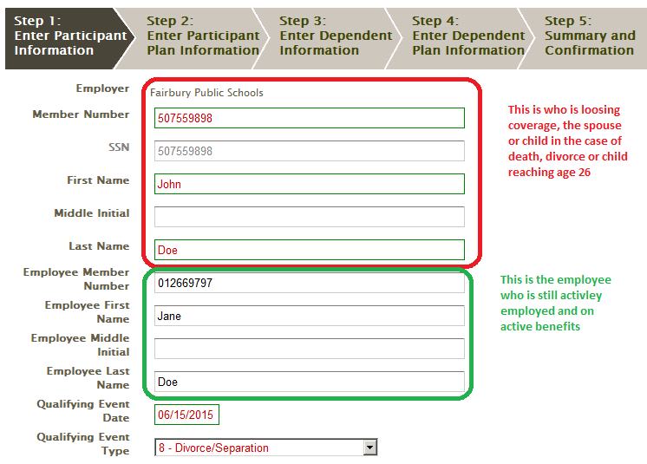
Non employee centered events
With the exception of the green box all the information you enter will be for the person loosing coverage. The address, gender, birth date, etc., needs to be that of the person loosing coverage. Do not enter the person loosing coverage under the dependent section.

Slide 13
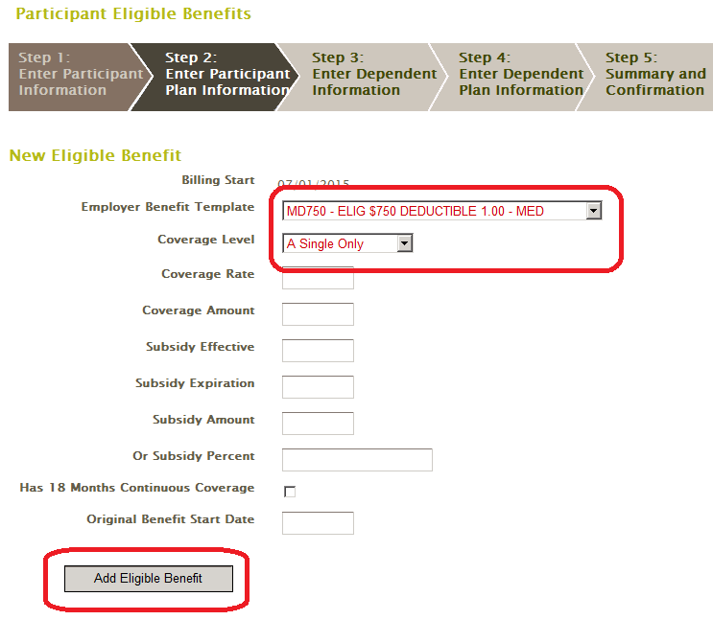
Adding benefits
Select coverage for the member. In the case of a dependent centered event you would select single coverage in most cases even if the active employee had spouse, children or family level coverage. This is due to only one person is loosing coverage in most cases. In the case of a employee death event and they had a spouse and one or more children covered you would choose coverage level "E Single + Children". Then you would enter the childrens' information in th dependent screens.

Slide 14
PayFlex Responsibilities to BCBS
Notification of new COBRA enrollments
Notification of termination or status changes from COBRA
Remittance of monthly premiums received

Slide 15
Participant Responsibility
Return COBRA enrollment forms within 60 days
Remit payment within 45 days of returning enrollment forms
Continue to pay premium monthly within the 30 day grace period

Slide 16


ENGAGEMENT TOOLS/
WEB DEMOS

Slide 17
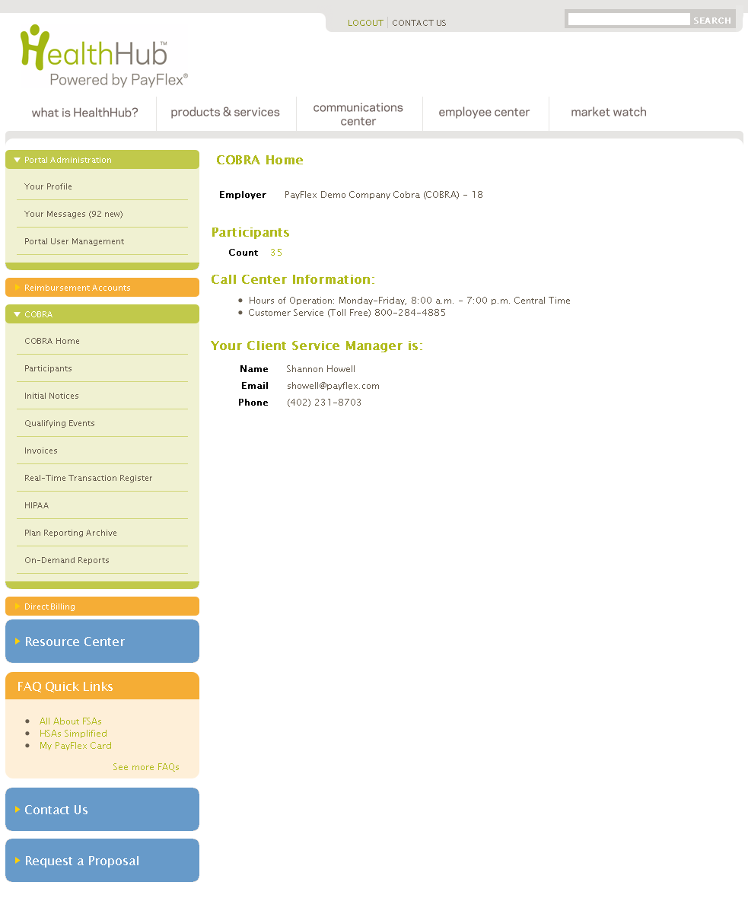
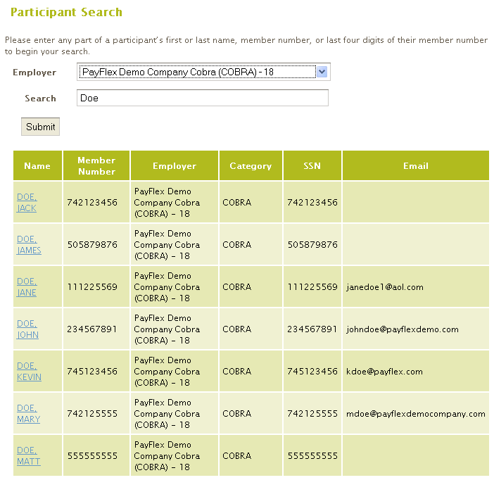
HealthHub.com
COBRA Employer Portal
Real-time access
  Account status
  Participant benefits
  Payments history
  Archived documents
  Dependent information
Account management
  Enter Initial Notices
  Enter Qualifying Events
  Enter HIPAA Notices (COC)
  Access administrative billing/invoices
  Assign account roles
Reporting capabilities
  Participant Amount Billed
  Participant Paid Thru Report
  Employer Census Report
  Participant Payments & Refunds
Keeping you informed
Account messages
Legislative updates
Reporting archive
Jean Romano
jromano@payflex.com
(402) 231-8618

Slide 18
HealthHub.com
COBRA Employer Portal
Log in
  Email address or first initial last name
  Password is auto generated and sent via email
  Change password under ‘Your Profile’
Account management
  Click on COBRA to open window
  Click on Initial Notices to enter new employee information
  Click on Qualifying Events to enter participant information
Reporting capabilities
  Click on Plan Reporting Archive
  ARRA Report
  Employer Census Report
  Participant Paid Thru Report
  Participant Payments & Refunds
Jean Romano
jromano@payflex.com
(402) 231-8618

Slide 19

HealthHub.com
COBRA Participant Portal
Real-time access
  Account status
  Coverage levels
  Dependent information
  Payment history
  Account management
  Enroll in COBRA online
  Initiate one-time and recurring payments online
  Keeping you informed
  View correspondence generated by the COBRA platform
  Manage user credentials and electronic notifications
  View frequently asked questions

