Slide 1
HEALTH SAVINGS ACCOUNTS

Slide 2
Presented by:
Bobbi Hanigan
Union Bank & Trust Company

Slide 3
Benefits of an HSA
You see the true cost of medical care and have better control over how your dollars are spent
Funds roll over from year to year
There is no “use it” or “lose it”
Funds belong to you - regardless

Slide 4
Who Can Open a
Health Savings Account?
Age Requirement: 18 or older
Must be enrolled in a qualifying High Deductible Health Plan (HDHP)
Cannot be covered by any non-qualified HDHP Health Insurance
Account is owned by the insured
Unused Funds may roll over to next plan year and beyond
Cannot be enrolled in Medicare
Cannot be claimed as a dependent on another individual’s tax return

Slide 5
HSA Contributions
Maximum annual contribution amount for 2012 is:
- $3,100 Individual coverage
- $6,250 Family Coverage
2012 Catch-up Contributions for HSA owners ages 55+
  - $1,000 for 2009 and thereafter
  ****if the account owner has a spouse who is covered under the HDHP, and they are 55+ ---they qualify to make the catch-up contribution – this contribution would need to be into their own account!

Slide 6
2013 HSA Contributions
Maximum annual contribution amount for 2013 is:
- $3,250 Individual coverage
- $6,450 Family Coverage
2013 Catch-up Contributions for HSA owners ages 55+
  - $1,000 for 2009 and thereafter
  ****if the account owner has a spouse who is covered under the HDHP, and they are 55+ ---they qualify to make the catch-up contribution – this contribution would need to be into their own account!

Slide 7
HSA Contributions (continued)
Contributions can be made as late as April 15 of the following year
Anyone can contribute to an HSA for you
Contributions are Tax deductible (unless made by your employer)
Tax-Free earnings through investments/interest
Excess Contributions must be withdrawn and taxed as ordinary income plus an additional 10% excise tax

Slide 8
HSA Distributions
Distributions for qualified medical, dental or vision expenses are not taxed
Non-qualified expenses are taxable as ordinary income plus an additional 20% penalty
(exceptions: individual’s death, disability or reaching age 65)
Distributions for non-qualified expenses taken after age 65 are taxed current tax rate and are NOT subject to the 20% penalty

Slide 9
What Medical Expenses Qualify?
Prescriptions and qualified deductible expenses
Qualified long-term care services and a percentage of long term care insurance premiums
COBRA premiums
Health insurance for those on unemployment compensation
Eye Exams
Dental Exams

Slide 10
Advantages of HSAs
Triple Tax Savings:
Tax deductions when you contribute to your account
Tax-free earnings through investments/interest
Tax-free withdrawals for qualified medical expenses
Portability-accounts are completely portable if you:
  Change your medical coverage
Move to another state
Change your marital status

Slide 11
HSA Beneficiaries
Surviving spouse becomes the owner of the account and can use it as if it were their own HSA
No surviving spouse? The account is no longer treated as an HSA. The account passes to your beneficiary, or becomes part of your estate (and is subject to any applicable taxes)

Slide 12
Two Types of Accounts to Meet Your Savings and Investment Needs
Deposit HSA
Variable Balance
High Activity
Easily Accessible
Online Bill Pay
FDIC Insured Account
Mutual Fund Account
Growth-oriented account
Low level of activity
Higher balances
Online Management
Not FDIC Insured!
Notes:
.

Slide 13
Accessibility
The balances in your Deposit HSA Account are immediately accessible using your:
HSA Debit Card
Online BillPay
Checks-you may choose to purchase checks for your account!
Notes:
Regardless of the type of account you select or the funds you select accessibility
is the key to HSA accounts. You can use these funds as needed or invested
for eligible expenses. There are no fees with this account but there are limits to
what you can invest.
You can have both types of accounts but you may not exceed annual
contribution limits set by the IRS.

Slide 14
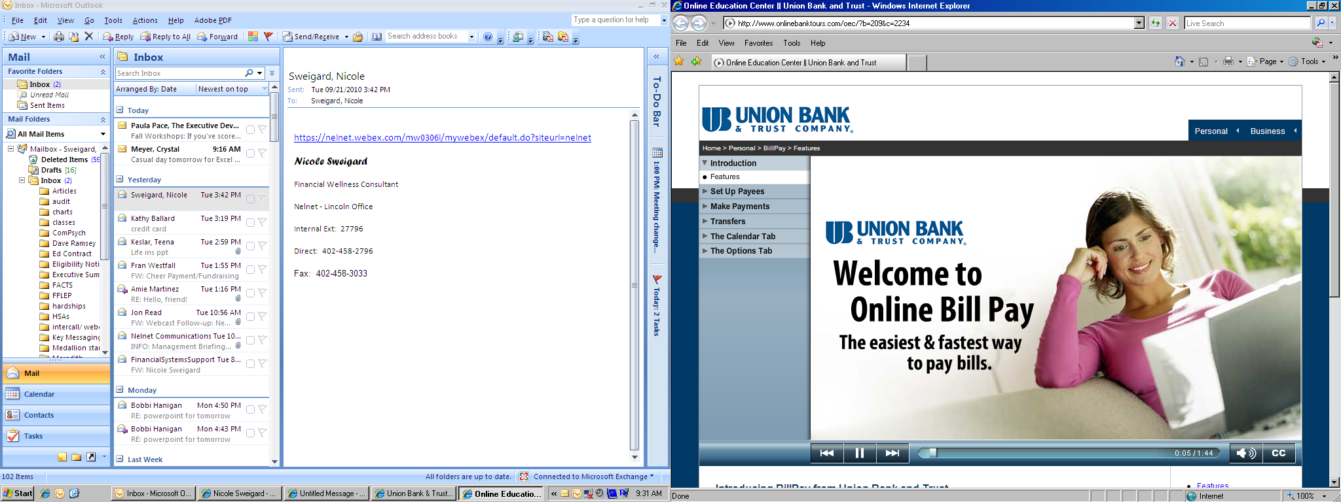
Online Bill Pay
http://www.ubt.com/tools/library/demos.html
Notes:
Pay any merchant
Set up recurring payments
Track online

Slide 15
HSA Enrollment Process for Deposit HSA Account
Union Bank & Trust is excited to announce…….
E-Signature!!!!
Simply log onto www.ubt.com
Select Online Applications (middle of right side)
Select Health Savings Account (bottom of left side)
Complete application as instructed
Remember to Select “EMPLOYER SPONSORED PLAN”
Account is opened and you will receive your account number at this time! Remember to record it for future reference.

Slide 16
Health Savings Accounts
Encourage Healthy Living
Preventative care is not a deductible expense and is covered at 100% by your CDHP
Proactive approach to health care
The money that you do not use in the account is yours to keep – an incentive to live a healthy lifestyle

Slide 17
Account Owner Responsibility
If you have specific tax questions, please consult your tax professional
Union Bank & Trust is not responsible for monitoring the account for proper usage
Please remember that when used properly, the Health Savings Account offers Triple Tax Savings!! Tax-Free Contributions, Tax-Free Earnings, and Tax-Free Qualified Distributions
It is the Account Owner’s responsibility to maintain all records and receipts for the account

Slide 18
Union Bank & Trust HSA Contact
Bobbi Hanigan Heather Poysa
(402) 323-1482 (402) 323-1351
Bobbi.Hanigan@ubt.com Heather.Poysa@ubt.com
Toll Free: 1-800-297-2837
hsa@ubt.com

